Slide 1


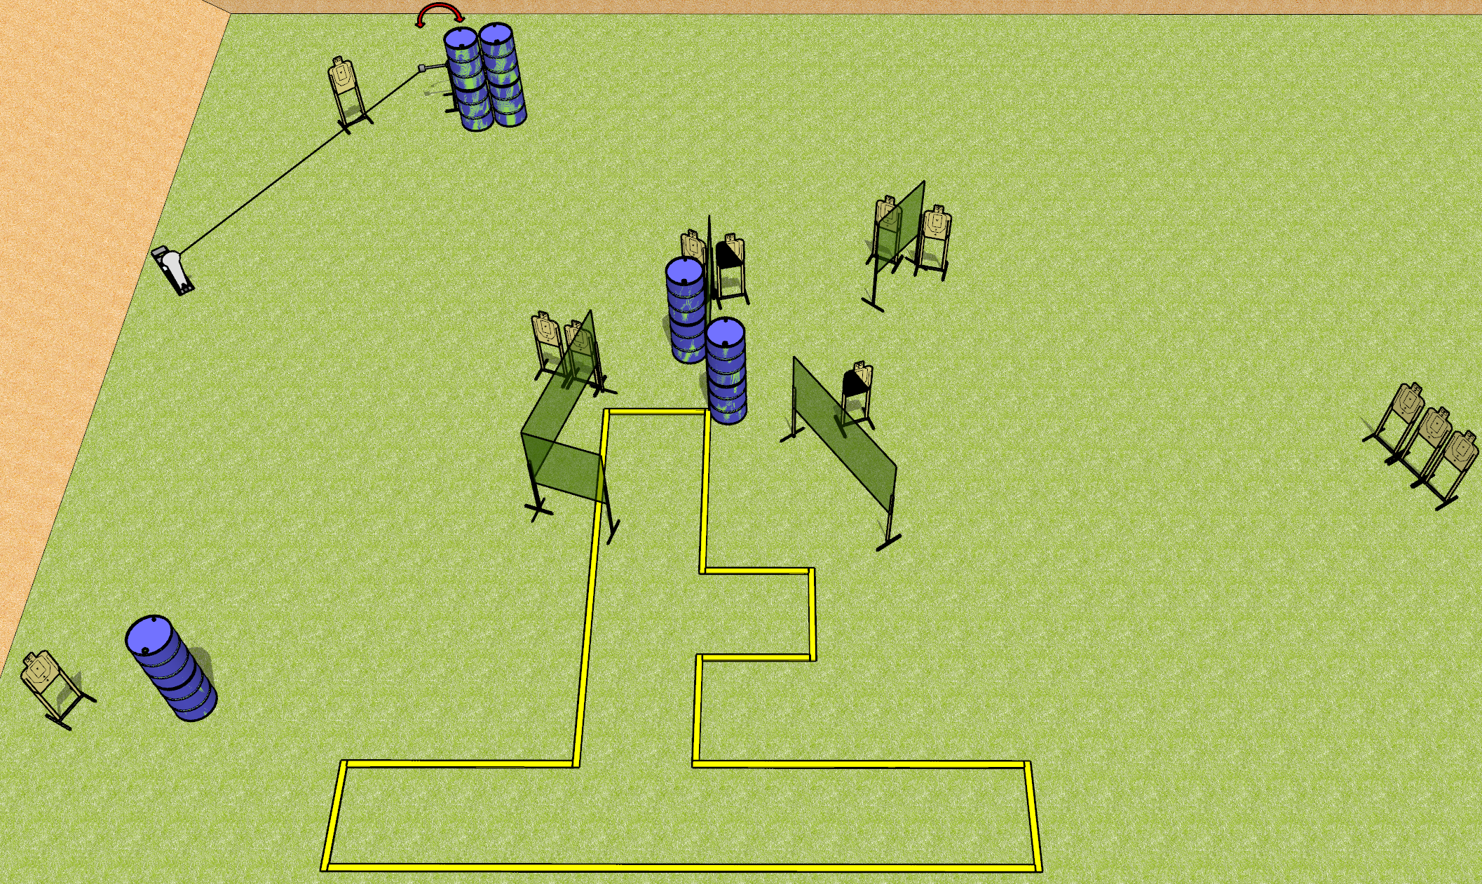
 | Dothan Gun Club – USPSA Match Surprise Course Designer : Drew Coleman
Round Count 27 rounds 13 USPSA 1 Colt popper
Equipment List 6 medium fault lines 9 wall feet 2 left diag 11 targets

Slide 2
Surprise
Written Stage Briefing
Surprise is a 27 round, 135 point, Comstock course of fire. There are 13 USPSA targets and 1 colt popper. The best 2 hits on paper will score, and steel must fall to score.
The swinger is activated by the colt popper and remains visible at rest.
Handgun start position is inside shooting area, wrists below belt. Handgun is loaded and holstered.
PCC start position is inside shooting area, stock on belt. Loaded carbine is held with both hands, safety on.
On the audible start signal, engage targets as they become available from within the shooting area.

